Slide 1


<Yuan Feng>
<Dec 24, 2023>

Slide 2

Outline
Executive Summary
Introduction
Methodology
Results
Conclusion
Appendix

Slide 3
Executive Summary
This is a comprehensive program focused on data collection, processing and visualization. Based on the SpaceX Falcon 9 dataset, we experienced the entire process of treatment in different ways

Slide 4
Introduction
Project background and context
Space X advertises Falcon 9 rocket launches on its website with a cost of 62 million dollars; other providers cost upward of 165 million dollars each, much of the savings is because Space X can reuse the first stage. Therefore, if we can determine if the first stage will land, we can determine the cost of a launch. This information can be used if an alternate company wants to bid against space X for a rocket launch. This goal of the project is to create a machine learning pipeline to predict if the first stage will land successfully.
Problems you want to find answers
What factors determine if the rocket will land successfully?
The interaction amongst various features that determine the success rate of a successful landing.
What operating conditions need to be in place to ensure a successful landing program.

Slide 5

Section 1

Slide 6
Methodology
Executive Summary
Data collection methodology:
Describe how data was collected
Perform data wrangling
Describe how data was processed
Perform exploratory data analysis (EDA) using visualization and SQL
Perform interactive visual analytics using Folium and Plotly Dash
Perform predictive analysis using classification models
How to build, tune, evaluate classification models

Slide 7
Data Collection
The data is collected from URL SpaceX API, which using get request package in python
Decode the response content into Json format using .json(), and transfer to pandas dataframe using .json_normalize()
Cleaning data
Additional, perform web scraping from Wiki for Falcon 9 launch records (BeautifulSoup)

Slide 8
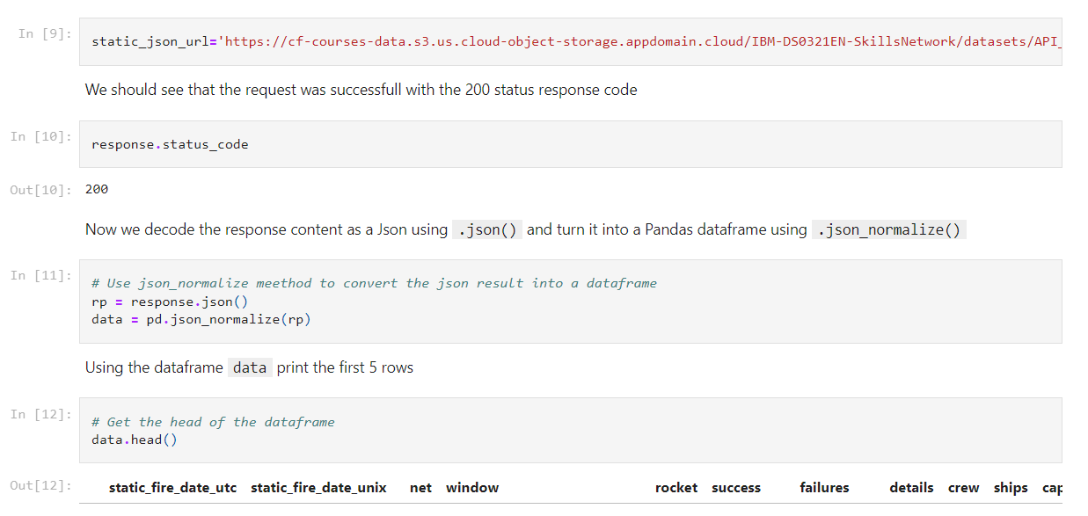
Data Collection – SpaceX API
Use get request to SpaceX API to collect data, with some preprocessing.
https://github.com/YaleFeng/Applied-Data-Science-Capstone/blob/main/jupyter-labs-spacex-data-collection-api.ipynb
Place your flowchart of SpaceX API calls here

Slide 9
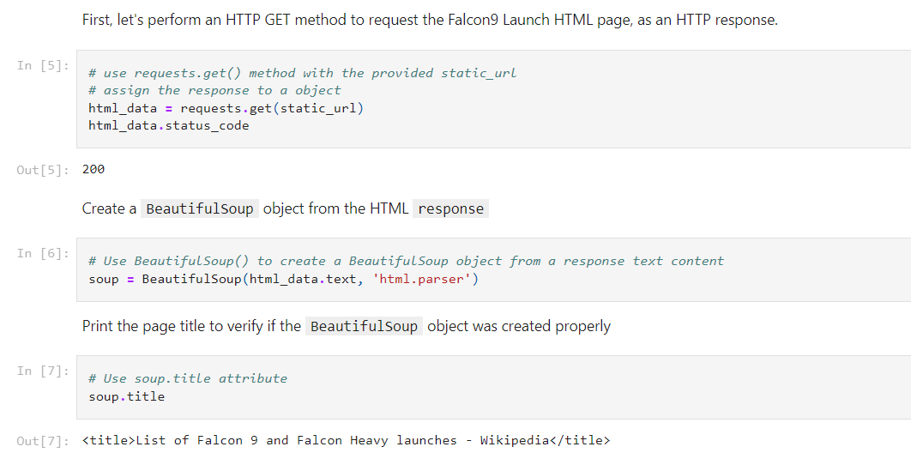
Data Collection - Scraping
Using BeautifulSoup to grab the records, parsed the table and converted into pandas dataframe
https://github.com/YaleFeng/Applied-Data-Science-Capstone/blob/main/jupyter-labs-webscraping.ipynb
Place your flowchart of web scraping here

Slide 10
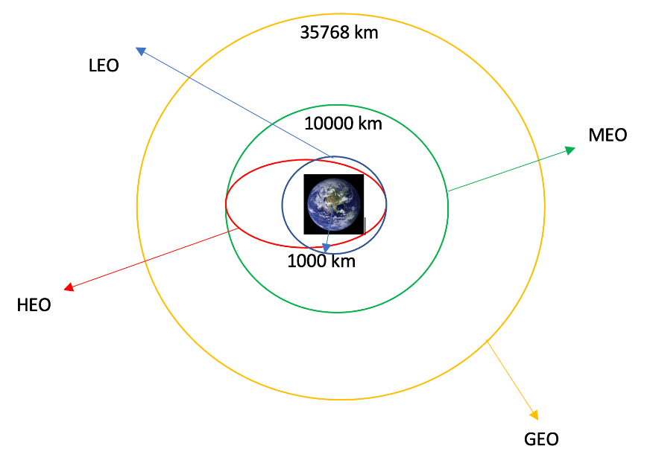
Data Wrangling
Calculated the number of launches at each site, and the number and occurrence of each orbits
Created landing outcome label from outcome column
https://github.com/YaleFeng/Applied-Data-Science-Capstone/blob/main/labs-jupyter-spacex-Data%20wrangling.ipynb

Slide 11
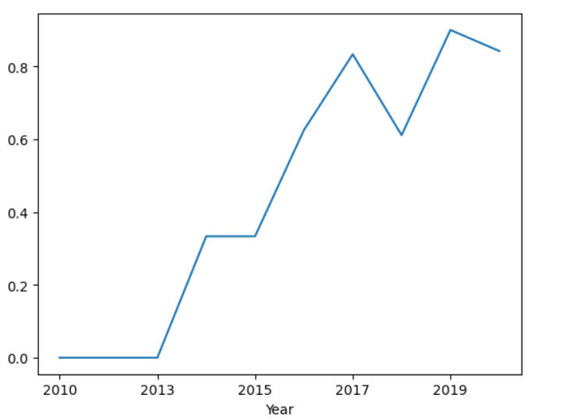
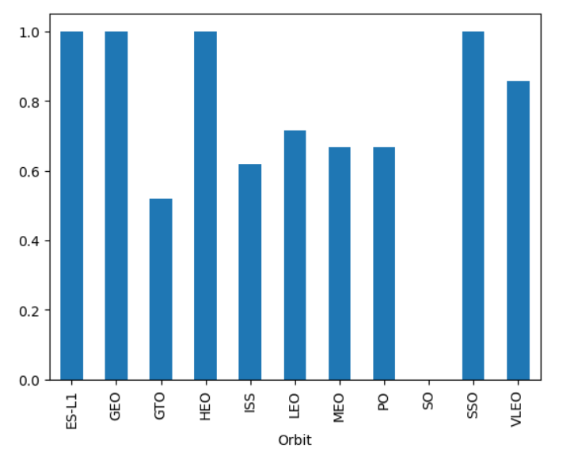
EDA with Data Visualization
We explored the data by visualizing the relationship between flight number and launch Site, payload and launch site, success rate of each orbit type, flight number and orbit type, the launch success yearly trend.
All charts in github https://github.com/YaleFeng/Applied-Data-Science-Capstone/blob/main/jupyter-labs-eda-dataviz.ipynb

Slide 12
EDA with SQL
We applied EDA with SQL to get insight from the data. We wrote queries to find out for instance:
The names of unique launch sites in the space mission.
The total payload mass carried by boosters launched by NASA (CRS)
The average payload mass carried by booster version F9 v1.1
The total number of successful and failure mission outcomes
The failed landing outcomes in drone ship, their booster version and launch site names
https://github.com/YaleFeng/Applied-Data-Science-Capstone/blob/main/jupyter-labs-eda-sql-coursera_sqllite.ipynb

Slide 13
Build an Interactive Map with Folium
We assigned the feature launch outcomes (failure or success) to class 0 and 1 i.e., 0 for failure, and 1 for success.
Using the color-labeled marker clusters, we identified which launch sites have relatively high success rate.
Are launch sites near railways, highways and coastlines.
Do launch sites keep certain distance away from cities
https://github.com/YaleFeng/Applied-Data-Science-Capstone/blob/main/lab_jupyter_launch_site_location.ipynb

Slide 14
Build a Dashboard with Plotly Dash
Plot pie charts showing the total launches by a certain sites
Plot the scatter charts showing the relationship between Outcome and Payload (Kg) for the different version
https://github.com/YaleFeng/Applied-Data-Science-Capstone/blob/main/dashboard.py

Slide 15
Predictive Analysis (Classification)
Import data using numpy and pandas, preprocess the data and split the data into train and test set
Build multiple models and tune different hyperparameters using cross validation
Using accuracy as the score of each model
Find the best model with best hyperparameter
https://github.com/YaleFeng/Applied-Data-Science-Capstone/blob/main/SpaceX_Machine_Learning_Prediction_Part_5.jupyterlite.ipynb

Slide 16
Results
Exploratory data analysis results
Interactive analytics demo in screenshots
Predictive analysis results

Slide 17

Section 2

Slide 18
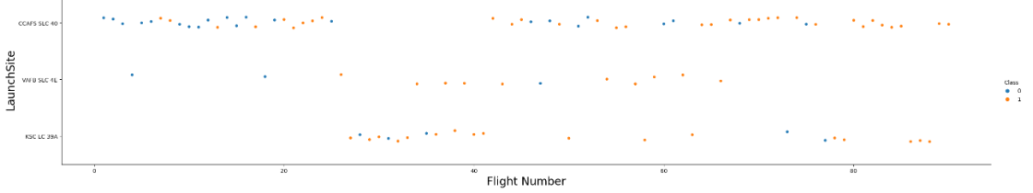
Flight Number vs. Launch Site
Larger flight number contain more success rate at launch site

Slide 19
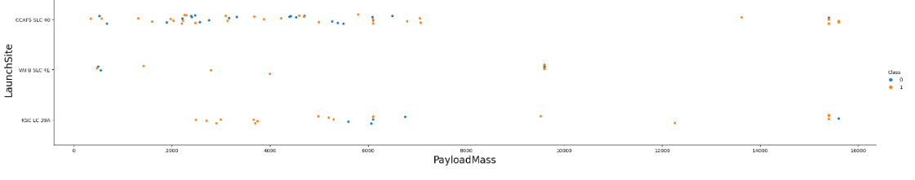
Payload vs. Launch Site
Larger payload in CCAFS SLC 40 brings higher success rate

Slide 20

Success Rate vs. Orbit Type
We could see four Orbit types contain highest success rate almost 100%

Slide 21
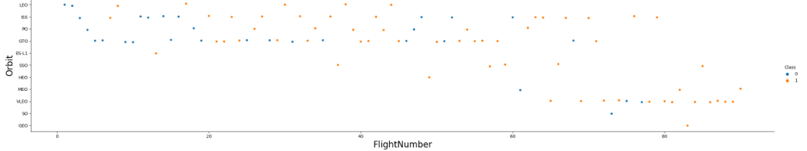
Flight Number vs. Orbit Type
There is no quite correlated relationship between flight number and orbit about the success rate

Slide 22
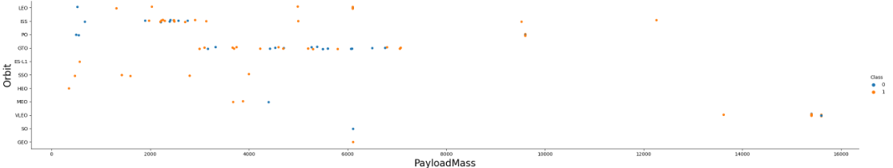
Payload vs. Orbit Type
With larger payload, more like to be success in PO, LEO and ISS

Slide 23
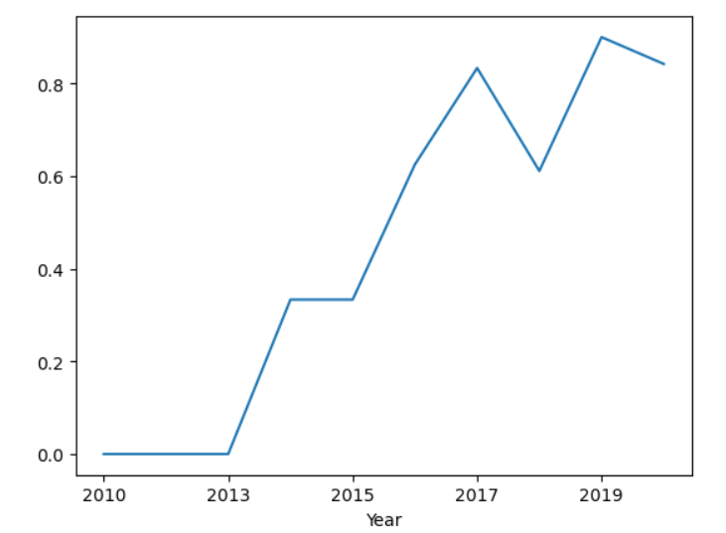
Launch Success Yearly Trend
The success rate growth during the year, and it close to normal success

Slide 24
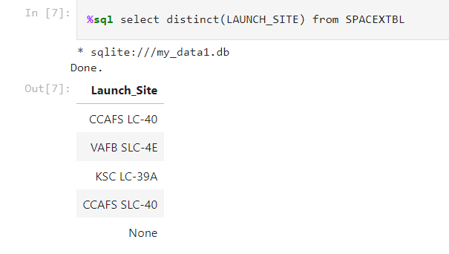
All Launch Site Names
Key: DISTINCT()

Slide 25
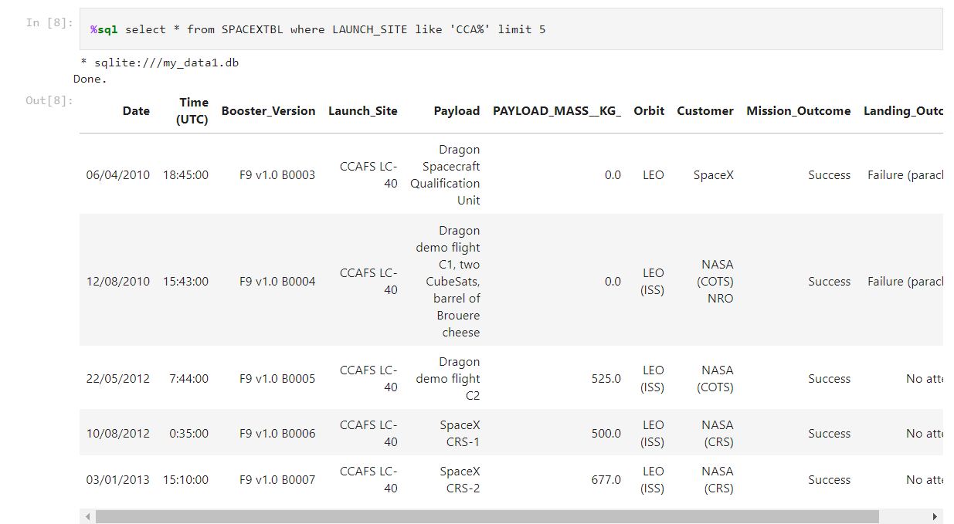
Launch Site Names Begin with 'CCA'
Use LIKE in WHERE

Slide 26
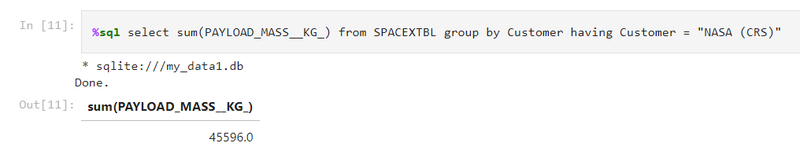
Total Payload Mass
Get to know the aggregate function SUM()

Slide 27
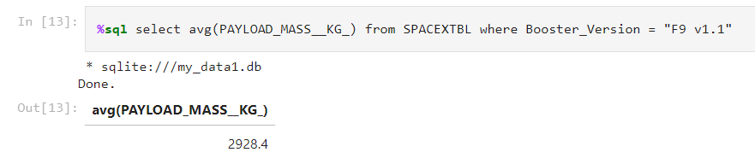
Average Payload Mass by F9 v1.1
Aggregate function AVG()

Slide 28
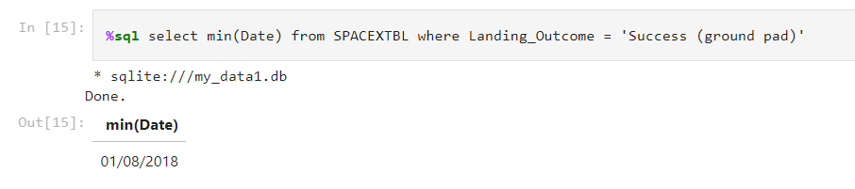
First Successful Ground Landing Date
Aggregate function MIN()

Slide 29
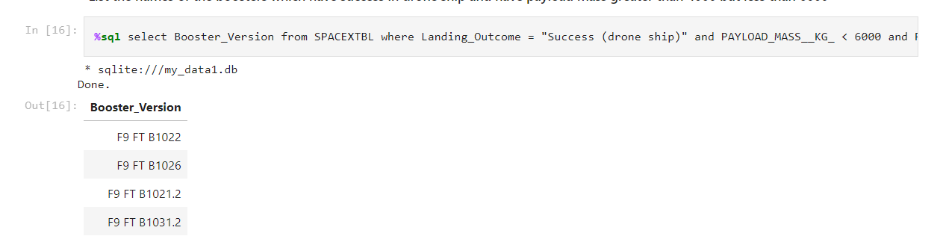
Successful Drone Ship Landing with Payload between 4000 and 6000
Condition limit

Slide 30
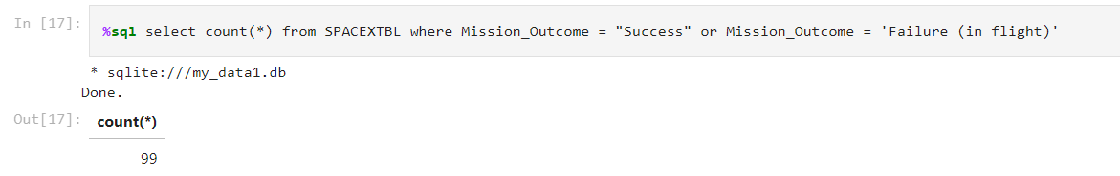
Total Number of Successful and Failure Mission Outcomes
Aggregate function COUNT()

Slide 31
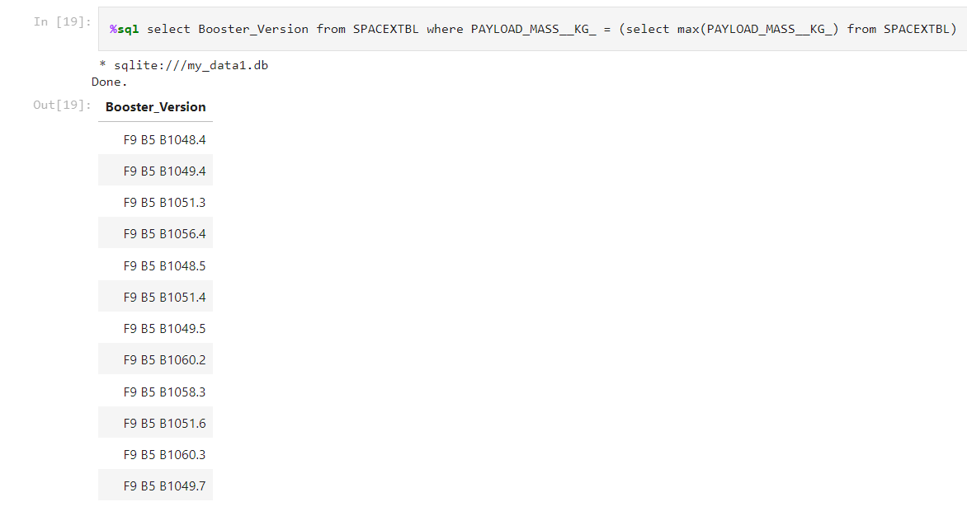
Boosters Carried Maximum Payload
Subquery technique

Slide 32
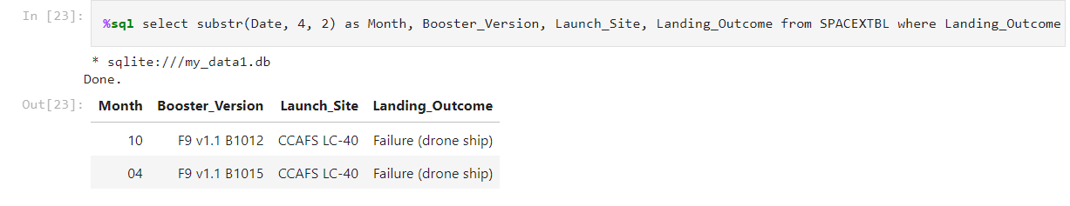
2015 Launch Records
Substring function

Slide 33
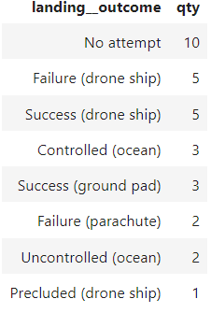
Rank Landing Outcomes Between 2010-06-04 and 2017-03-20

Slide 34

Section 3

Slide 35
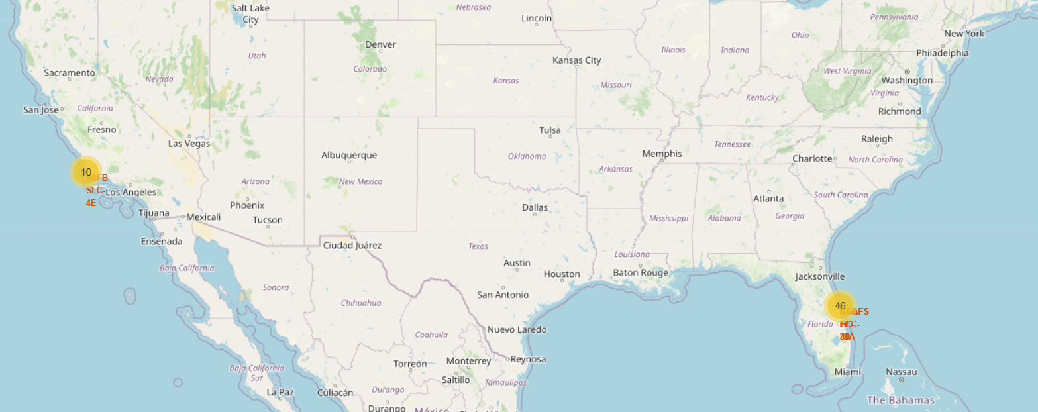
All launch sites
Two location close to sea and on south

Slide 36
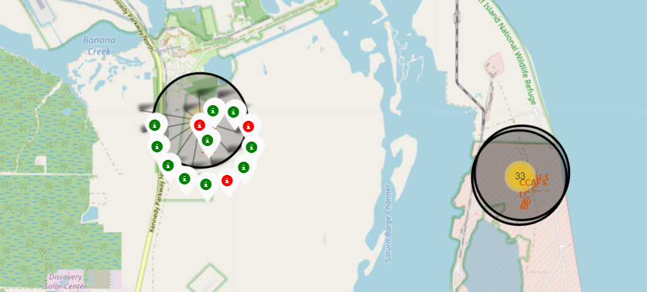
Outcome by site
Green for success and red for fail

Slide 37
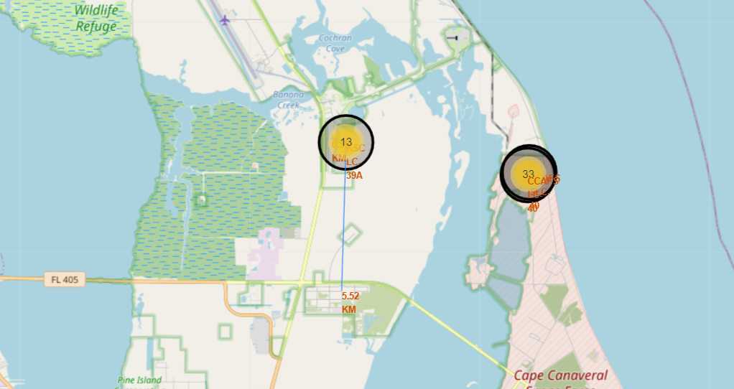
Safety
Near railway and far away from living area

Slide 38

Section 4

Slide 39
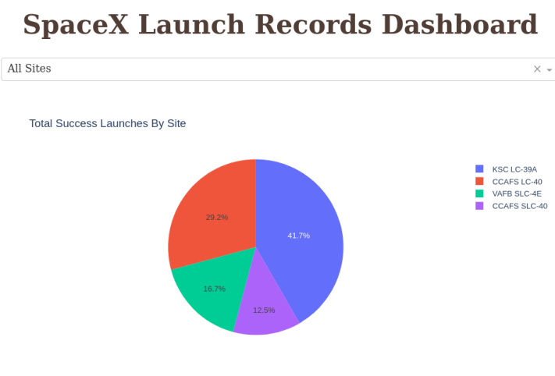
Success rate with launches
Different launches have different success rate

Slide 40
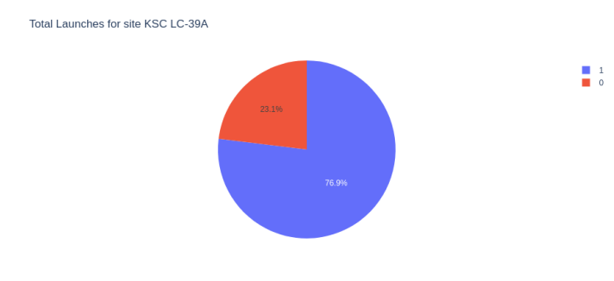
Success Ratio for KSC LC-39A
Focus on each launch success rate, example KSC LC-39A

Slide 41
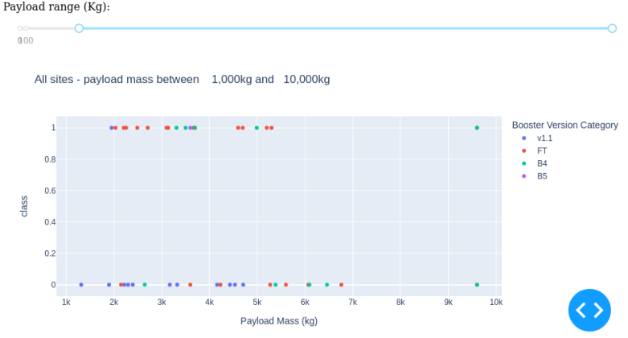
EDA visual chart in dashboard

Slide 42

Section 5

Slide 43
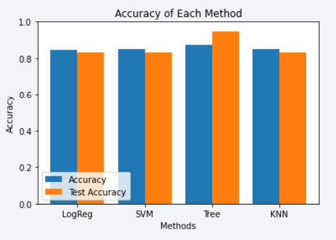
Classification Accuracy
Decision tree classification provides the best accuracy in this task
All method did well, could select either of them

Slide 44
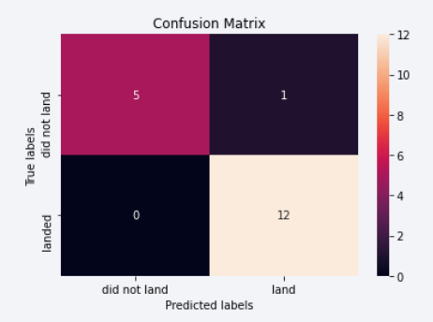
Confusion Matrix
Type I and II error are both small

Slide 45
Conclusions
The best launch site is KSC LC-39A based on success rate
Heavier launches brings less risky
Safety improved during on year
Decision tree classification does the best job on classification task

Slide 46
Appendix
https://github.com/YaleFeng/Applied-Data-Science-Capstone/tree/main

Slide 47


